Slide 1

C N H | K E Y C L U B
Time Management
Presented by:
Claudia Diaz, D16 Lieutenant Governor
|
R7TC
Training Topic: Time Management

Slide 2
"Better three hours too soon, than one minute too late."
-William Shakespeare
“Early is on time, on time is late, and late is unacceptable.”
- Jacqueline Tsang, D3N Lt. Governor
|
R7TC
Training Topic: Time Management
CNH Key Club District

Slide 3
Why is Time Management Important?
By using your time effectively and efficiently, you optimize the amount of things you get done in as little time as possible. You will also ensure that you finish what needs to be done before its deadline.
Be able to have control over your life-manage your time, don’t let it manage you!
To be healthier and happier (less stress).
|
R7TC
Training Topic: Time Management
CNH Key Club District

Slide 4


Why is Time Management Important?
|
R7TC
Training Topic: Time Management
CNH Key Club District

Slide 5
Benefits of Managing Your Time
1. Keeps you on track
2. Maximizes your productivity
3. Less time wasted=Less stress later
|
R7TC
Training Topic: Time Management
CNH Key Club District

Slide 6
Tools to Stay on Track
Daily Planners
Wall Calendars
Phone Calendars
"To Do" Lists
When doing homework or any work, go to a quiet place where you know you will get your work done.
|
R7TC
Training Topic: Time Management
CNH Key Club District

Slide 7
How to Gauge the Importance of Something
|
R7TC
Training Topic: Time Management
CNH Key Club District

Slide 8
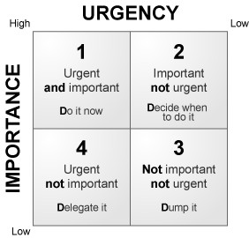
Important. Has a deadline.
Important. Has no deadline.
Not important. Has no deadline.
Not important. Has a deadline.
|
R7TC
Training Topic: Time Management
CNH Key Club District

Slide 9
These are most important (#1 Priorities). They are things that need to be done, and they have a specific time frame.
i.e.:
MRFs
Homework
College Apps
|
R7TC
Training Topic: Time Management
CNH Key Club District

Slide 10
These are also important. They are things that need to be done, however there is no specific time frame to do it.
i.e.:
Personal Health (exercise, eating)
(I know this sounds bad, but it's just in terms of time management)
|
R7TC
Training Topic: Time Management
CNH Key Club District

Slide 11
These are not important. Whether they have a deadline or not, they aren't things that need to be done. You do these after you've finished the the important tasks
i.e.:
Social Life (this is also just in terms of time management)
|
R7TC
Training Topic: Time Management
CNH Key Club District

Slide 12
How to Effectively Use your Time
When it falls into the #1 Priority category.
|
R7TC
Training Topic: Time Management
CNH Key Club District

Slide 13

Make a S.P.L.A.S.H.!
Schedule
Prioritize
List
Action
Submit
Hooray!
|
R7TC
Training Topic: Time Management
CNH Key Club District

Slide 14
How to Effectively Use your Time
When you don't have to submit anything in.
|
R7TC
Training Topic: Time Management
CNH Key Club District

Slide 15
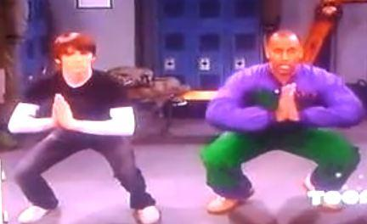
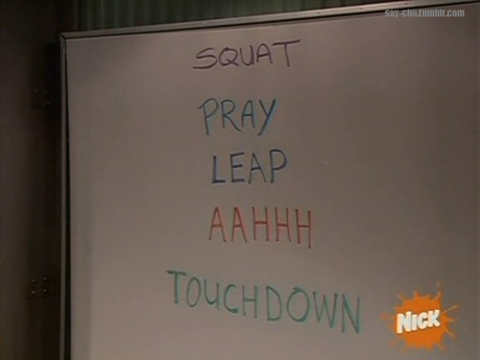
Remember... S.P.L.A.T.!
Schedule
Prioritize
List
Action
Tada!
|
R7TC
Training Topic: Time Management
CNH Key Club District

Slide 16
Biggest Adversaries to Efficient Time Management...
|
R7TC
Training Topic: Time Management
CNH Key Club District

Slide 17
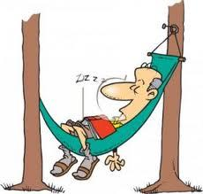
Laziness
"Laziness may appear attractive, but work gives satisfaction."
-Anne Frank
|
R7TC
Training Topic: Time Management
CNH Key Club District

Slide 18


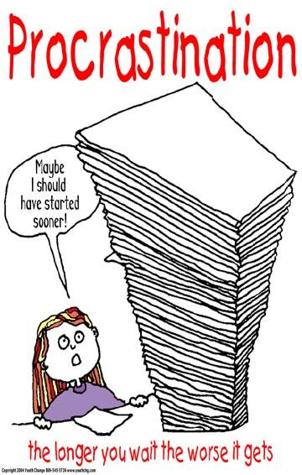





|
R7TC
Training Topic: Time Management
CNH Key Club District

Slide 19
As officers of Region 7...
We want to represent ourselves in a way that shows both responsibility and punctuality.
|
R7TC
Training Topic: Time Management
CNH Key Club District

Slide 20
Don’t forget…
Have a Vision (why are you doing all of this?)
Don't forget the "big picture" - why are you doing the task - is it important to your long-term personal goals?
Have and follow a personal mission statement (personal and career). (Are your activities ultimately helping you achieve your goals?)
Know what is important to you. (What do you value most?)
Have a positive attitude!
|
R7TC
Training Topic: Time Management
CNH Key Club District

Slide 21
Tools to Stay on Track
Plan Ahead (Schedule it and it will happen!)
Determine how long your tasks will take (do this before agreeing to take on a task!)
Consider whether any activities can be combined.
Determine if big tasks can be broken down into smaller tasks that may be easier to schedule or delegate (such as studying for exams and visiting the library as part of an assignment to write a term paper).
|
R7TC
Training Topic: Time Management
CNH Key Club District

Slide 22
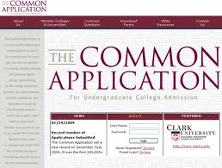
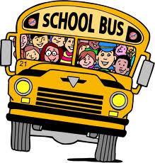

But I have so much to balance…
School
Key Club
Family
Friends
College Applications
|
R7TC
Training Topic: Time Management
CNH Key Club District

Slide 23



SAY NO
Say no to nonessential tasks. Consider your goals and schedule before agreeing to take on additional work.
|
R7TC
Training Topic: Time Management
CNH Key Club District

Slide 24
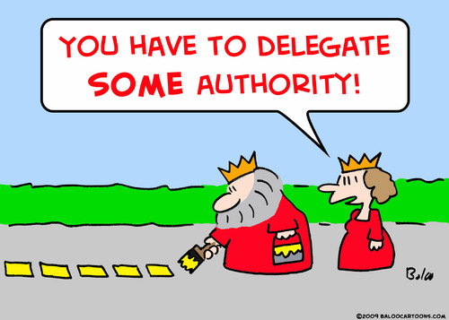
Delegate
  Be able to delegate tasks to peers
  Provide the opportunities for others to lead. Give them leadership opportunities that will inspire them to become leaders as well!
    Do not do everything by yourself!
    Learn to say “No”.
    Take a look at your to-do list and consider what you can pass on to someone else.
  Although you might prefer to do things yourself, take some weight off your shoulders and allow others to help you.
|
R7TC
Training Topic: Time Management
CNH Key Club District

Slide 25
Go for the GOLD!
Questions, Comments, Concerns
|
R7TC
Training Topic: Time Management
CNH Key Club District

